Slide 1
Internetworking
Devices that connect networks are called Internetworking devices.
A segment is a network which does not contain Internetworking devices.
Internetworking devices are divided into categories based on the OSI layer at which they operate.
  Repeaters operate at the physical layer.
  Bridges operate at the Data Link layer.
  Routers operate at the Network layer.
  Gateways operate at any layer higher than the Network layer

Slide 2
Repeater
Digital signals and analog carrier signals (that carry digital
information) can only be transmitted over a limited distance
because of attenuation or noise.
A repeater strips out and saves the received digital data.
It then reconstructs and retransmits the signal.
The new signal is an exact duplicate of the original
transmitted signal, able to travel over the new network
segment.
Since a repeater deals with signal reproduction and
transmission of data, it is a Physical layer device.
A repeater does not incorporate any changes to the addressing
or structure of the data associated with other layers.
It simply reconditions the received data and passes it on.
Notes:
Repeaters are network devices operating at physical layer of the OSI model that amplify or regenerate an incoming signal before retransmitting it. They are incorporated in networks to expand its coverage area. They are also known as signal boosters.

Slide 3
Bridges
A bridge is used to connect two LAN segments at the Data
Link layer, thus it must have two network interface cards.
As a Data Link layer device, bridges have access to station
address information.
In other words, they can determine the addresses of the source
and destination stations involved in the transfer.
Once determined, bridges can permit or deny access to the new
segment based on addresses and other Data Link layer
information such as Ethernet -to-Ethernet (same type of LANs)
Unlike repeaters, bridges are selective about the traffic they
allow through.
As bridges can filter by station address, they are usually used to
divide a too- busy network into separate segments.
After such a division, the bridge prevents intra-segment traffic
from reaching other segments.
This strategy effectively reduces traffic on each segment.
Notes:
Difference Between Bridge and Router. The basic difference between Bridge and Router is that Bridge is a network device mainly operating at the data link layer of the OSI model with filtering and forwarding capabilities. ... A router is attached to the two or more networks and forwards packets from one network to another.

Slide 4
How bridges work?
For example, consider a large corporate bus topology/contention
channel access network with several hundred stations.
Recently, network performance has fallen off because the
network is too heavily used.
Network administrators can solve the problem by dividing the
network's users into groups, based on geographic areas within a
building.
Users on the first floor use one segment; users on the second
floor will share the other segment.
Studies showed that inter-segment traffic will be minimal, so
this strategy will effectively isolate traffic and increase network
performance.
There are two kinds of bridges:
  Transparent (sometime called "learning" bridges).
  Source routing (found primarily in IBM networks).
Notes:
In transparent bridge mechanism bridges automatically develop a routing table.
In source routing bridge, bridges do not maintain any routing information.
Transparent bridges are fully transparent to the users.
Source routing bridges are not visible to the hosts.
Transparent bridge service is connectionless.
Source Routing Bridge service is connection oriented.

Slide 5
Transparent bridges
Transparent bridges require no initial programming.
After installation on a network, they "learn" the location of network devices by associating the source address in incoming packets with the line they were received on.
Using the relationship, transparent bridges build tables of device/segment pairs.
Bridges can then forward packets appropriately by analyzing a data packet's destination address.
If the destination address is on the segment from which the packet came, the bridge discards it.
If not, the packet is sent out on the appropriate line.
Notes:
A transparent bridge is a common type of bridge that observes incoming network traffic to identify media access control (MAC) addresses. ... Transparent bridges are implemented primarily in Ethernet networks. A device that ties two network segments together. Commonly used in Ethernet networks and also called an "adaptive bridge," the transparent bridge learns which node is connected to which port by examining the packets transmitted to the port.

Slide 6
The Learning algorithm
If the address is in the tables then
Forward the packet onto the necessary port.
If the address is not in the tables, then
Forward the packet onto every port except for the port that the packet was received on, just to make sure the destination gets the message.
Add an entry in your internal tables linking the Source Address of the packet to whatever port the packet was received from.
Notes:
A learning algorithm is a method used to process data to extract patterns appropriate for application in a new situation. In particular, the goal is to adapt a system to a specific input-output transformation task.

Slide 7
Example of learning bridge
For example, consider a simple network consisting of a four-port transparent bridge with five stations attached to it.
The ports on the bridge are numbered one through four.
Station A and Station B are on port 1, no station is on port 2, Station C is on port 3, and Station D and Station E are on port 4.
Notes:
A bridge is a device that joins networks to create a much larger network. ... A learning bridge, also called an adaptive bridge, "learns" which network addresses are on one side of the bridge and which are on the other so it knows how to forward packets it receives.

Slide 8
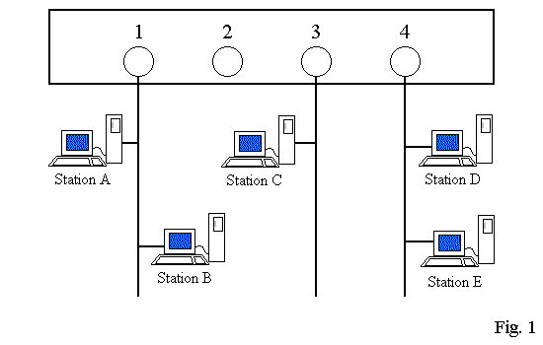
Example of learning bridge

Slide 9
Example of learning bridge
Station B transmits a packet destined for Station C.
Since the bridge doesn't know what port station B is on yet, it puts the packet out onto every port except Port 1 (the packet came from Port 1, so the bridge knows that the packet has already been seen by stations on Port 1).
This method is known as flooding.
The bridge also examines the Source Address in the packet and determines that Station B is attached to Port 1.
It updates its tables (see Fig. 2).

Slide 10
Example of learning bridge
Now the bridge knows where Station B is, it will forward packets destined for Station B only onto Port 1.
As stations transmit packets, the bridge will learn the location of more and more stations.
Finally, it will know the locations of all stations those are attached to its ports.
In this method, even if the bridge doesn't know the location of a station, packets still get sent to their destination, just with a tiny bit of wasted bandwidth.
Finally, the bridge adds each entry in its internal tables and deletes the entry if, after a period of time known as the aging time, the bridge has not received any traffic from that station. This is just an extra safeguard to keep the bridge's tables up-to-date.

Slide 11
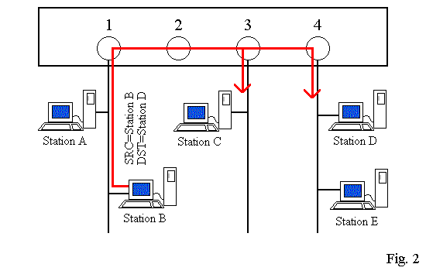
Example of learning bridge

Slide 12
Advantages of Transparent Bridges
Self learning: requires no manual configuration.
Independent of higher level protocols (TCP/IP).

Slide 13
Disadvantages of Transparent Bridges
Can only work with one path between segments.
Loops are not allowed. A loop would confuse the bridges as to which side of the bridge a node was really on, remote or local.
We cannot use Transparent bridges on MAN or WANs, because many paths can be taken to reach a destination.

Slide 14
Source routing bridge
In a source-routing network, the entire route to
the destination station is contained in the
packet sent by the source.
On the other hand, each source-routing bridge
must have the intelligence to determine the
appropriate route to all possible destinations.

Slide 15
Reasons to use a bridge
Security: Stops networks from forwarding sensitive data.
Bandwidth: Reduce traffic by segmentation
Reliability: If segment goes down, it will not affect the other segment.
Translation: Translate different Data Link protocols, such as Token ring to Ethernet.

Slide 16
Router
Like a bridge, a router must have at least two network
interface.
Bridge provides a means of interconnecting similar LANs.
The router is capable of connecting a variety of LANs and WANs.
Routers have access to information from all lower layers of
the protocol stack (Physical, Data Link, and Network).
Routers route packets based on the IP destination network,
not on the destination hosts.
Routers use one (or more) specific routing algorithm(s) to
calculate the best path through an internetwork.
Path may be calculated in real time (dynamically), so that
they can constantly adjust to changing network conditions.
Notes:
Difference Between Bridge and Router. The basic difference between Bridge and Router is that Bridge is a network device mainly operating at the data link layer of the OSI model with filtering and forwarding capabilities. ... A router is attached to the two or more networks and forwards packets from one network to another.

Slide 17
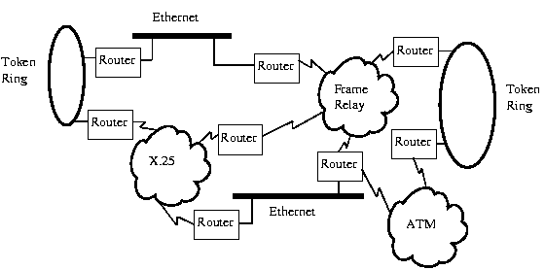
Router

Slide 18
Router
Routers are typically much more processing intensive than
bridges.
As a result, their processing speeds (usually measured in
packets forwarded per second) are not usually very high due to
much more sophisticated path selection based on routing
algorithms.
The decision to buy a bridge or a router depends on the
specific needs of each network administrator, and on existing
network environment.

Slide 19
Brouter
Many modern routers are actually brouters.
Brouters are essentially routers that can also be used as a
bridge.
Most routing algorithms are specific to particular
Network Layer protocols.
A brouter will first check a packet to see if it
supports the packet's routing algorithm.
If not, the packet is bridged using layer 2 (Link layer)
information.
Notes:
Finally, A gateway is a hardware device that acts as a "gate" between two networks. It may be a router, firewall, server, or other device that enables traffic to flow in and out of the network. While a gateway protects the nodes within network, it also a node itself.
A gateway is a node (router) in a computer network, a key stopping point for data on its way to or from other networks. Thanks to gateways, we are able to communicate and send data back and forth. The Internet wouldn't be any use to us without gateways (as well as a lot of other hardware and software).

